Slide 1
WEATHER APPLICATION
Guided by: Suvarna Mhasekar ma’am
Made by: Ashish Sagwekar(233701035) and Nitin N Sonkamble (233731104)

Slide 2
Contents:
Abstract
Scope/future scope
Limitations
System analysis
System design
Data model
User interface
Implementation details
Testing
Conclusion & recommendation

Slide 3
Abstract
Developed using Python, Tkinter(GUI) and MySQL, with API integration.
Delivers user-friendly interface, real-time weather info.
Offers insights for planning, travel and everyday decision making.
Helps in data retrieval, data parsing and error handling.
Room for future improvements, potential feature integration and interface enhancements, enabling continual development and growth.

Slide 4
Scope/future scope
Integration with OpenWeatherMap for real time weather data.
Dynamic background changes to reflect day or night
Error handling.
Various other details.
Improvements.
Feedback and usability tests

Slide 5
Limitations
Dependence on availability and reliability of the OpenWeatherAPI.
Limited features. Doesn't provide forecasts or historic data.
Not customisable.

Slide 6
System analysis
Existing system: web-bases weather websites, mobile apps, television and weather broadcasters.
Stakeholders: developers, users, OpenWeatherMap, System administers.
Requirement analysis:
Functional: required to register, login n view data by city.
Performance: required real time (3 seconds buffer) data retrieval.
Security: rewuires encryption, user validation and API key handling.

Slide 7
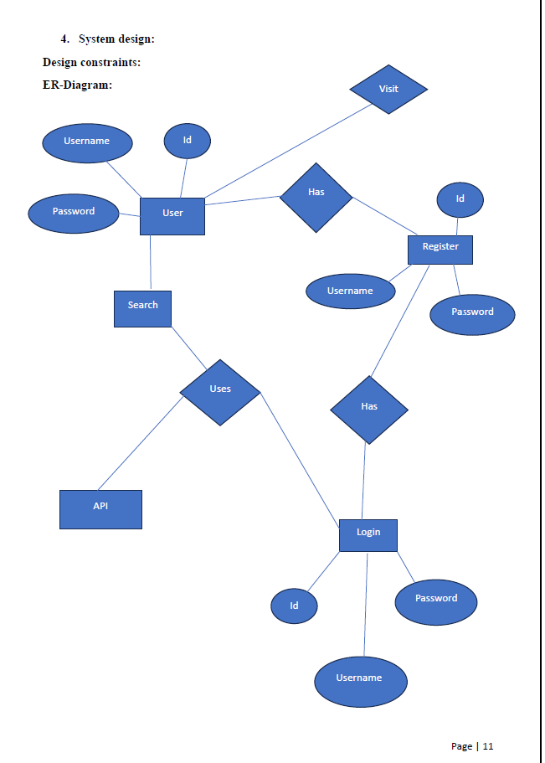
System design
ER-diagram

Slide 8
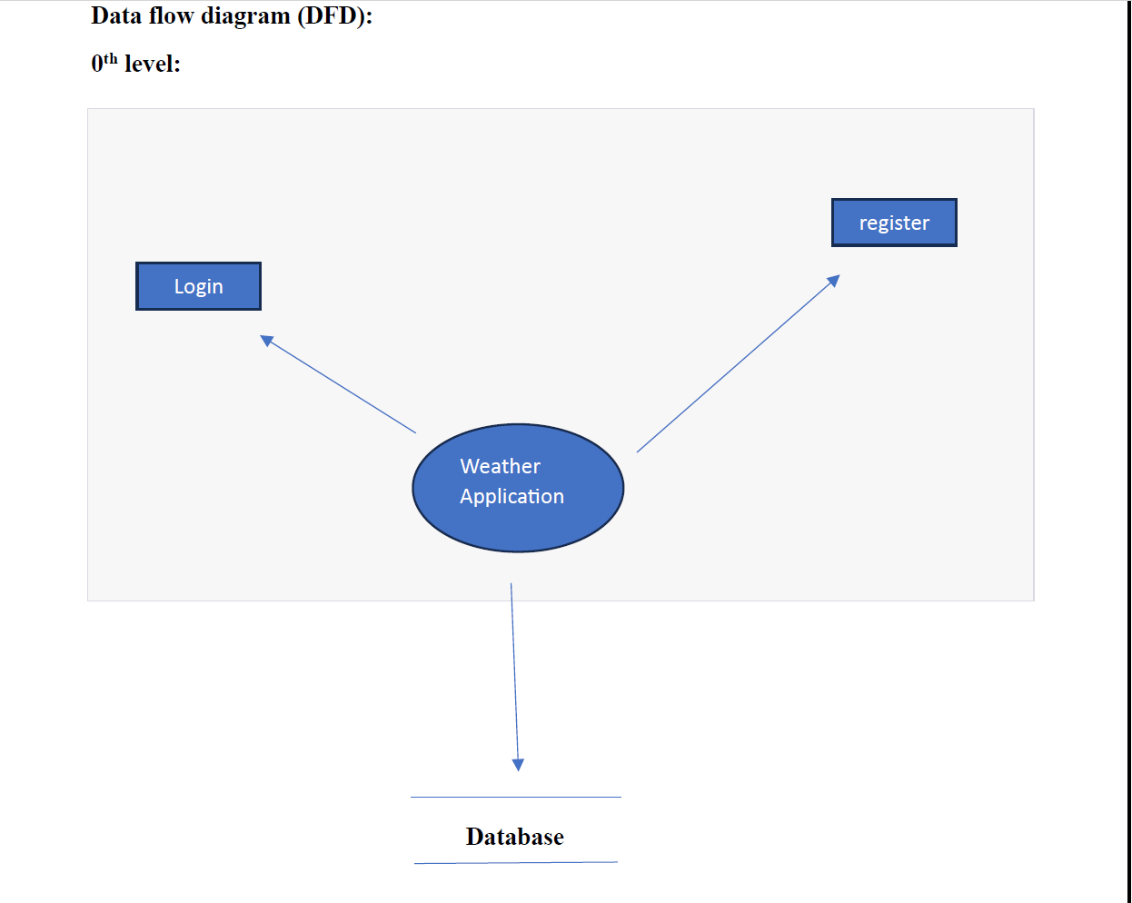
Data flow diagram
0th level

Slide 9
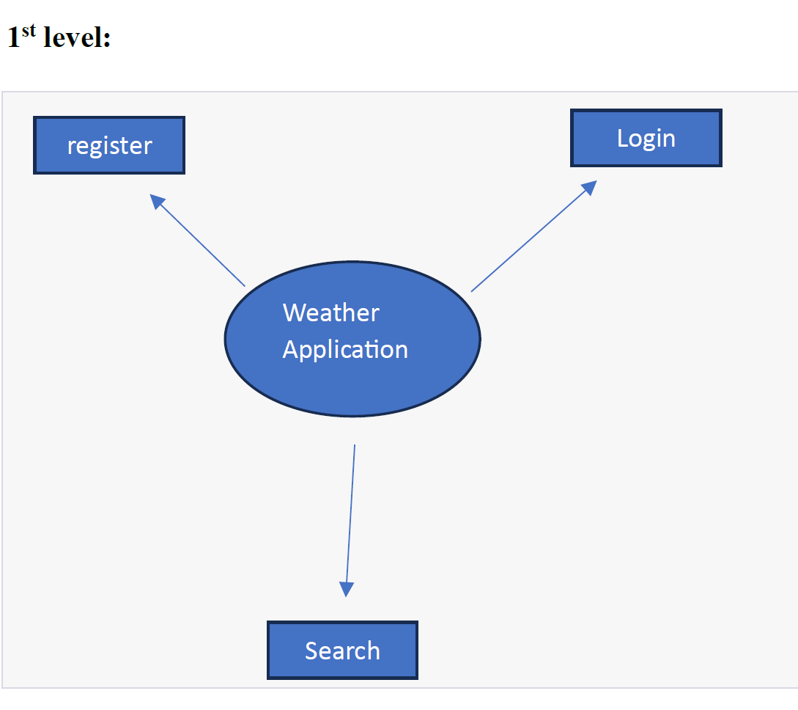
Data flow diagram
1st level

Slide 10
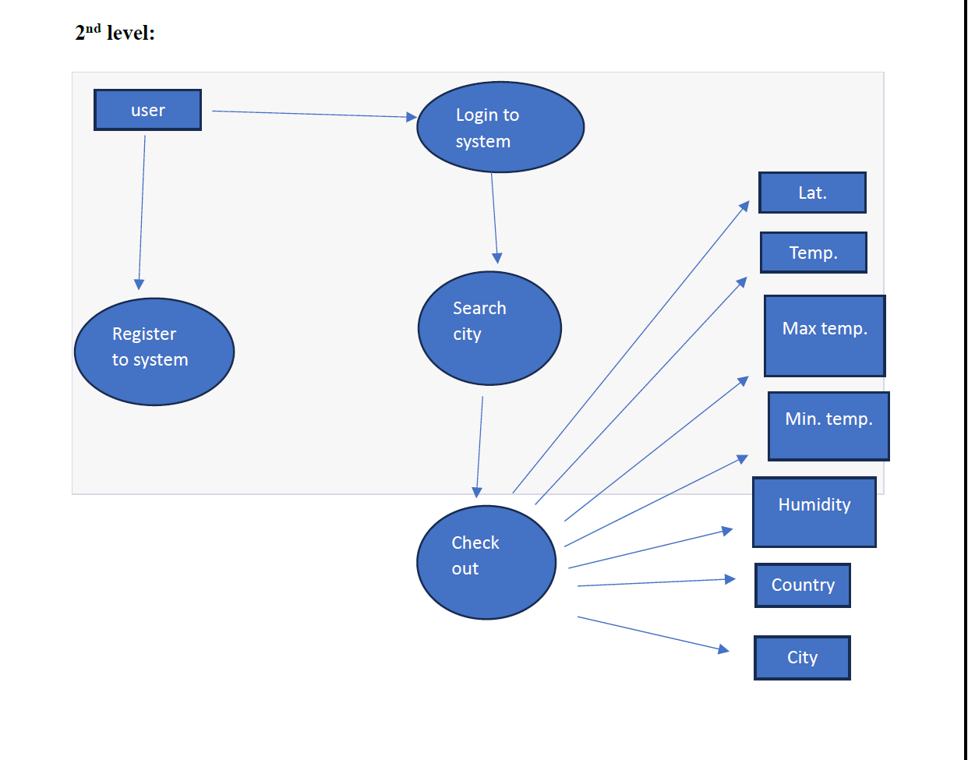
Data flow diagram
2nd level

Slide 11
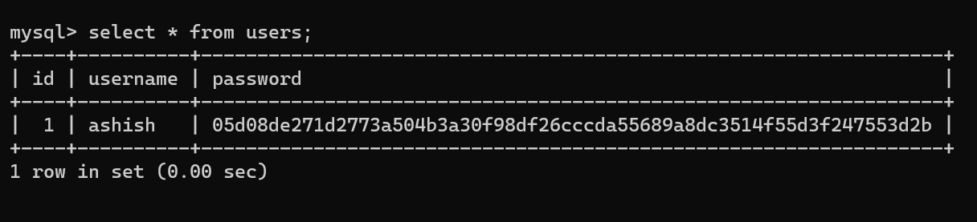
Data model

Slide 12
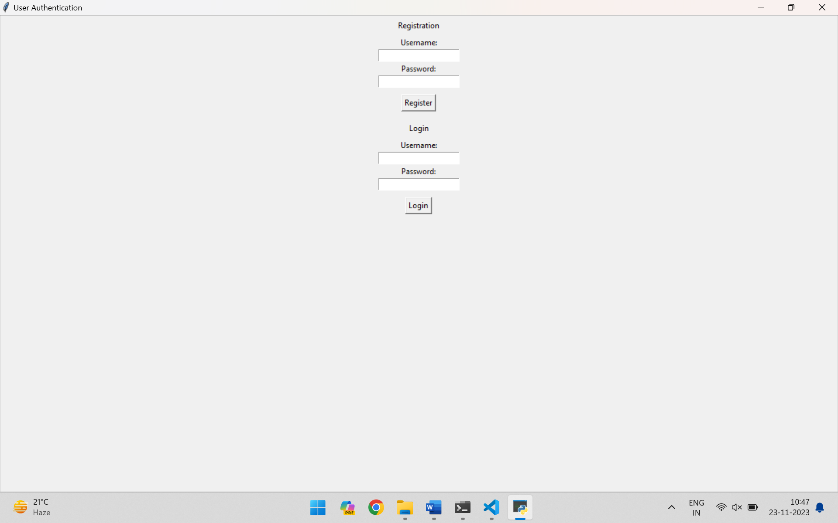
User interface
Registration and
Login window

Slide 13
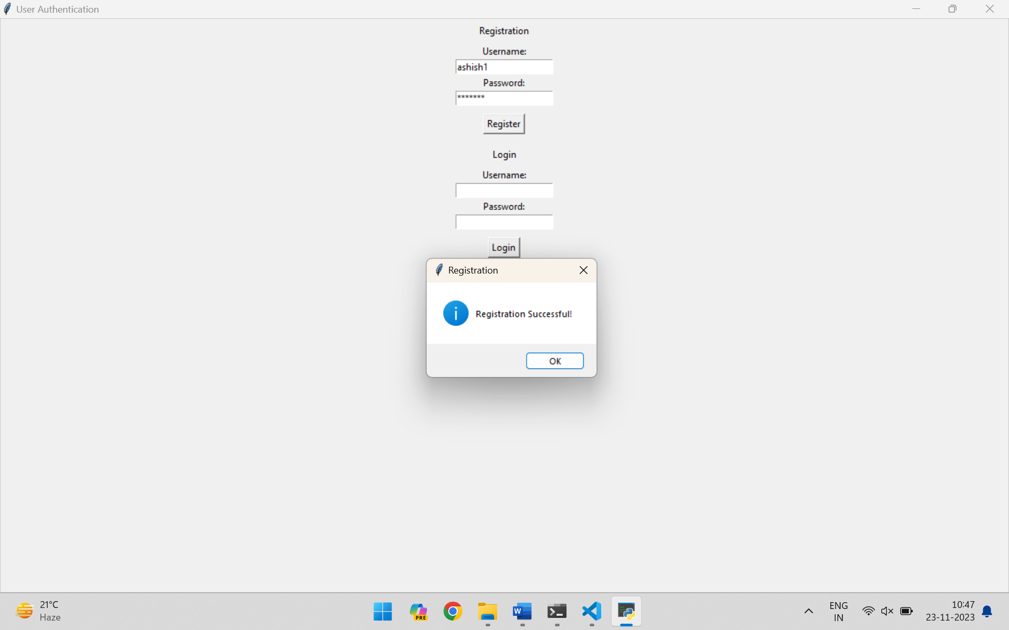
Registration successful
Window

Slide 14
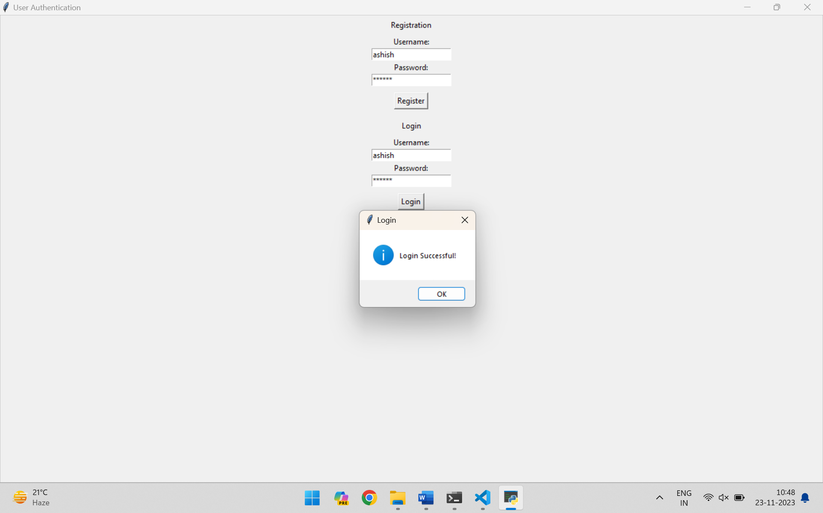
Login successful
Window

Slide 15
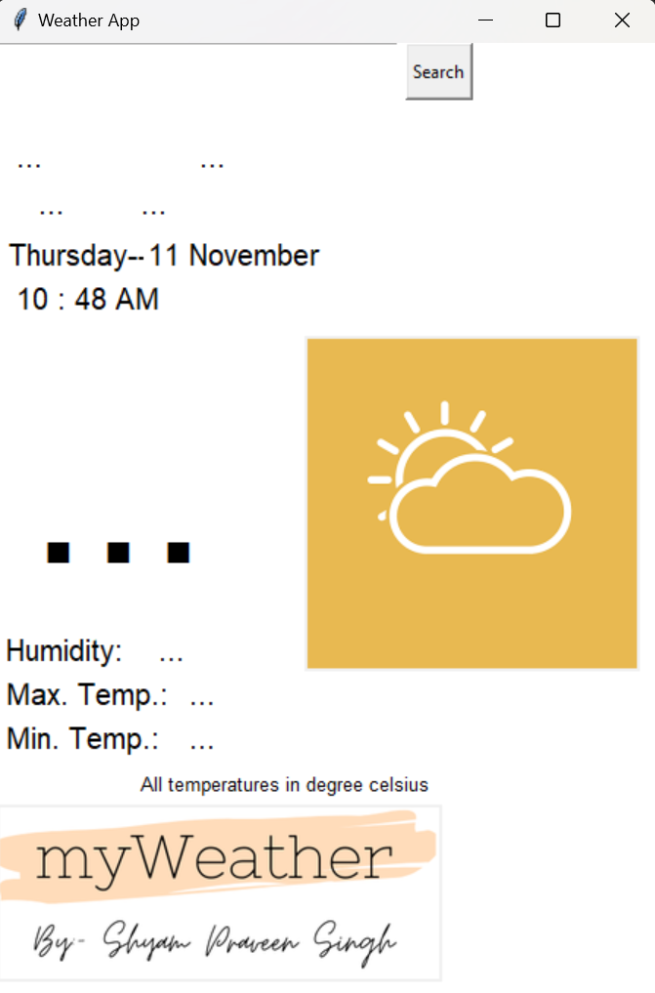
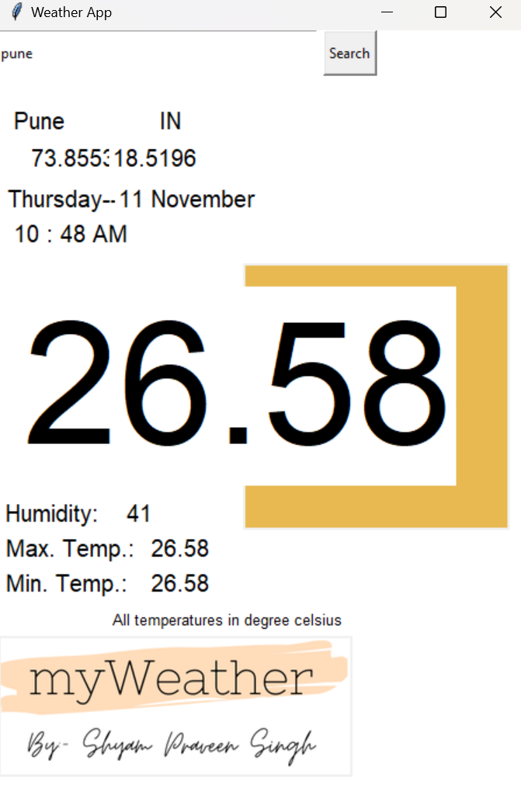
Weather app window

Slide 16
Implementation details: software specifications
Python, Tkinter and MySQL compatible Operating system.
Python installed (preferably Python 3.x).
Tkinter library (included I standard Python distribution)
PIL(python image library) can be installed using pip.
Request library.
Text editor or IDE (integrated development environment).
Pymysql installation, can be done using pip.

Slide 17
Implementation details: hardware specifications
Processor: dual-core capable of running Python and MySQL application efficiently.
RAM: min. 2GB.
Storage.
Display: to support GUI.
Internet connectivity.

Slide 18
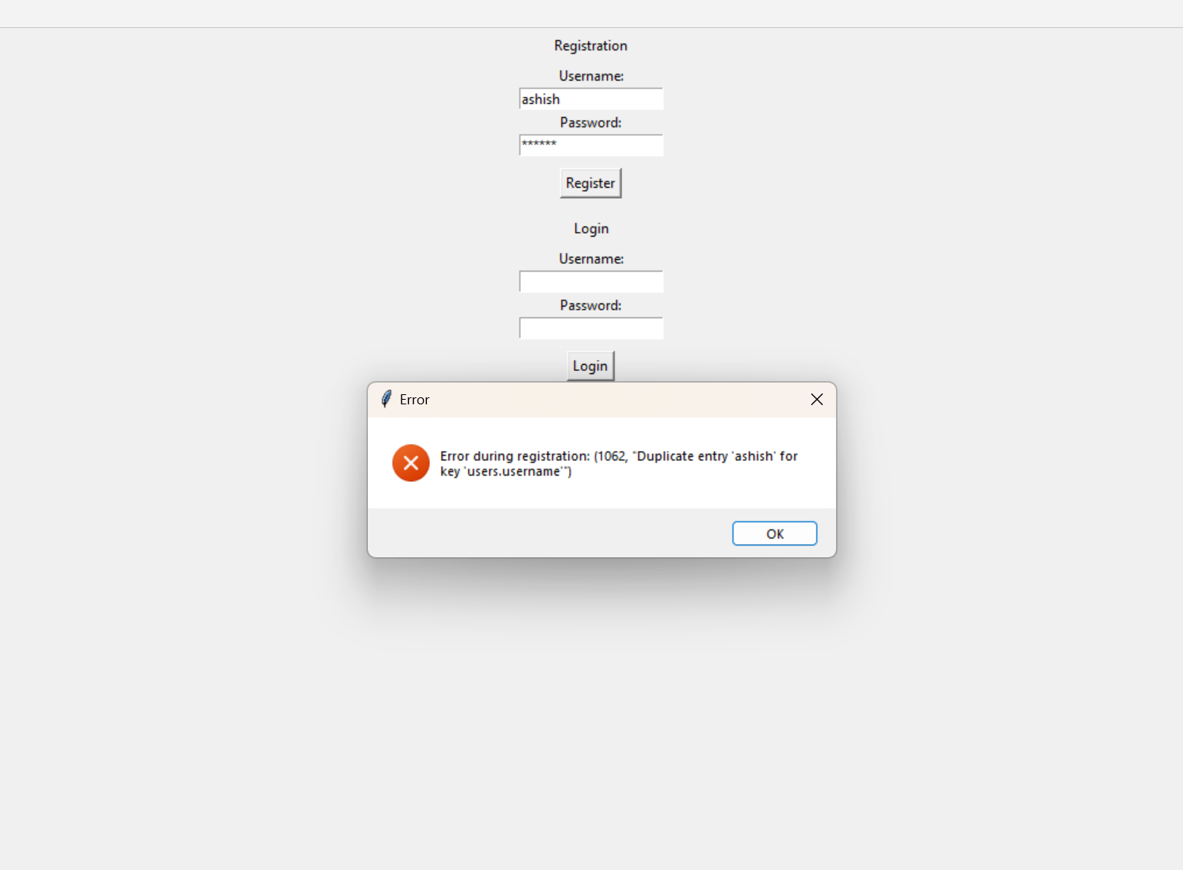
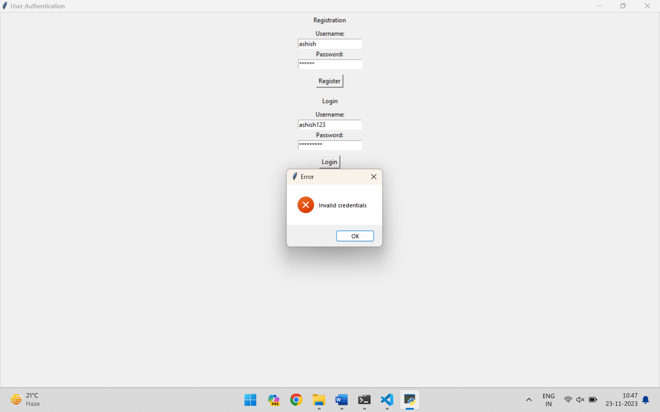
Testing
Tests before allowing access.

Slide 19
Conclusion and recommendation
Amalgamation of Python, Tkinter and MySQL offers a practical solution for users seeking real-time weather updates.
Problem solving skills.
Management skills.
Continual growth recommended.

Slide 20
Thank you!!

